Slide 1

Presentation Layer Patterns
Lecture 03
by Udara Samaratunge

Slide 2
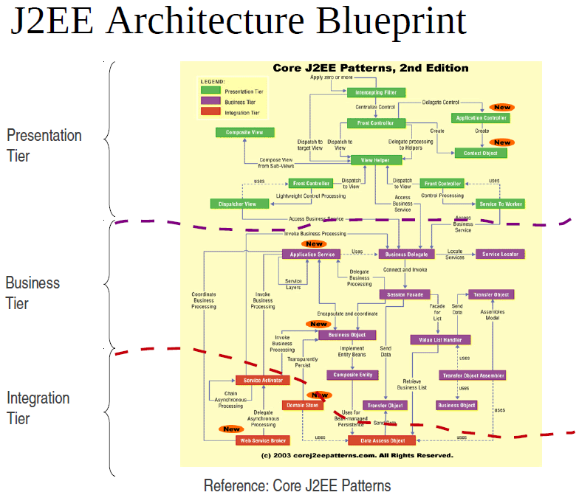

Slide 3
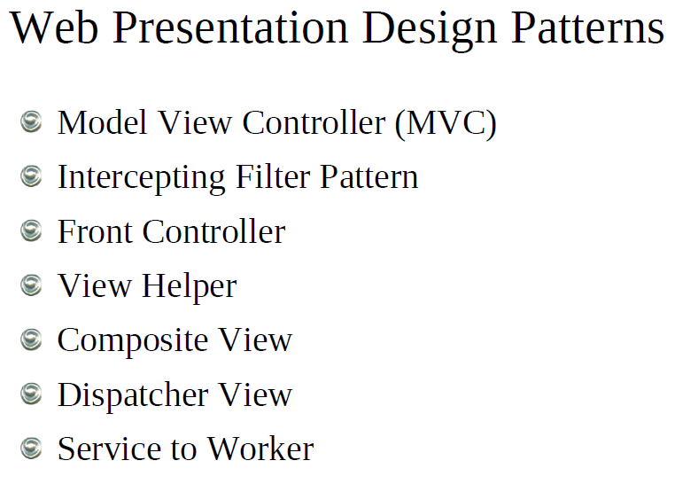

Slide 4
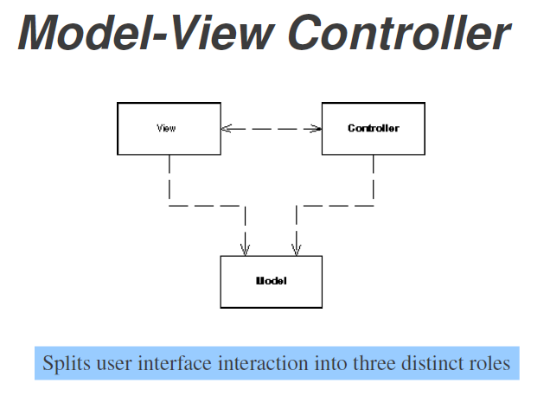

Slide 5
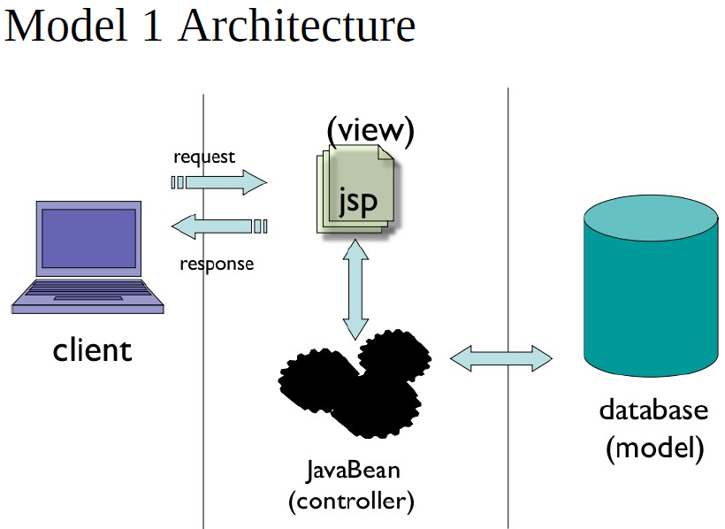
Notes:
Model 1 – Easy to Develop, as JSP need not to pre-compile

Slide 6
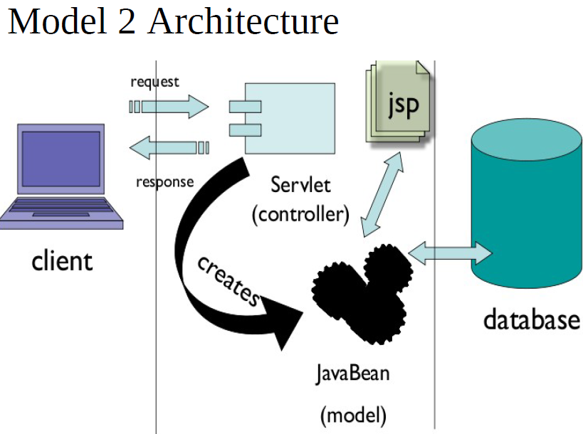
Notes:
Model 2 – Servlet can initiate a new Thread (over a process in CGI) to handle request

Slide 7
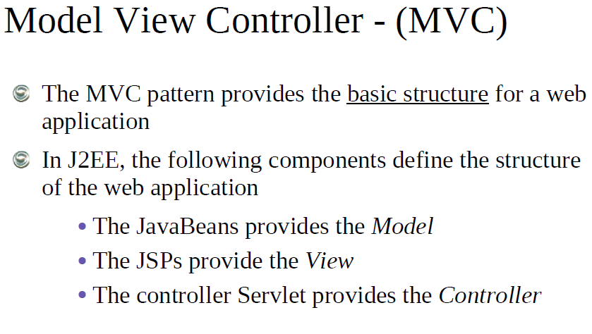

Slide 8
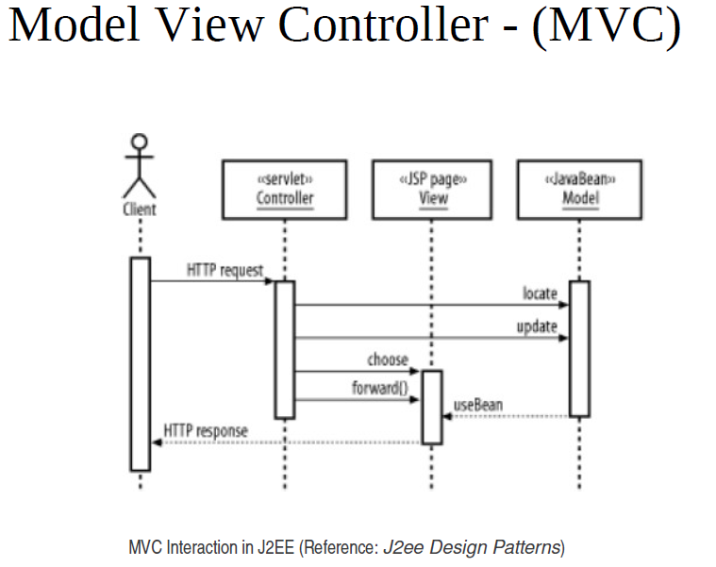

Slide 9
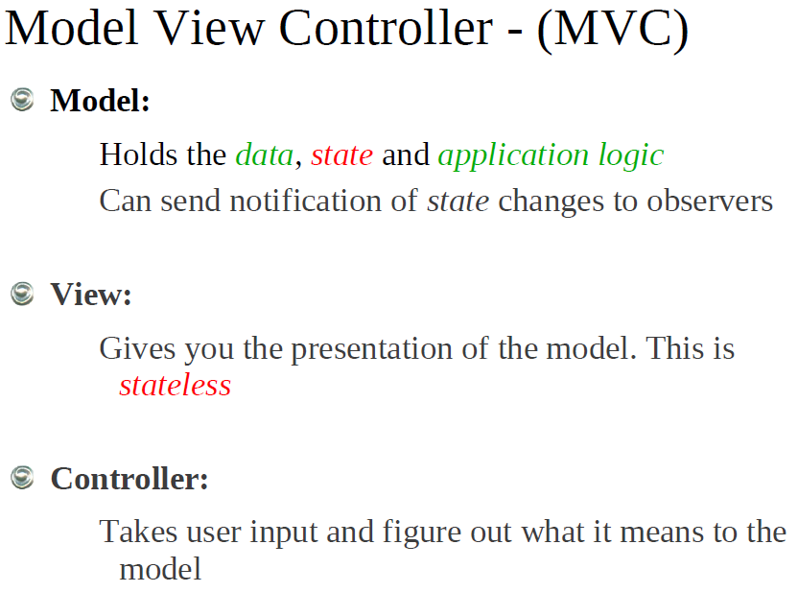

Slide 10
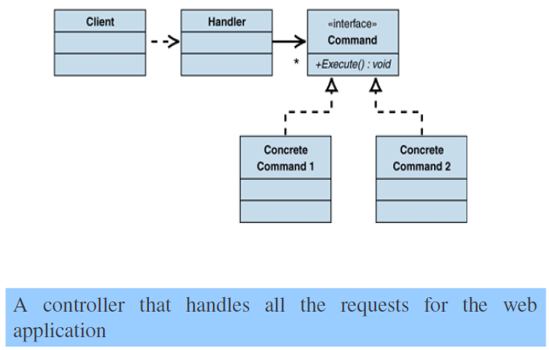
Front Controller

Slide 11
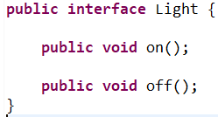
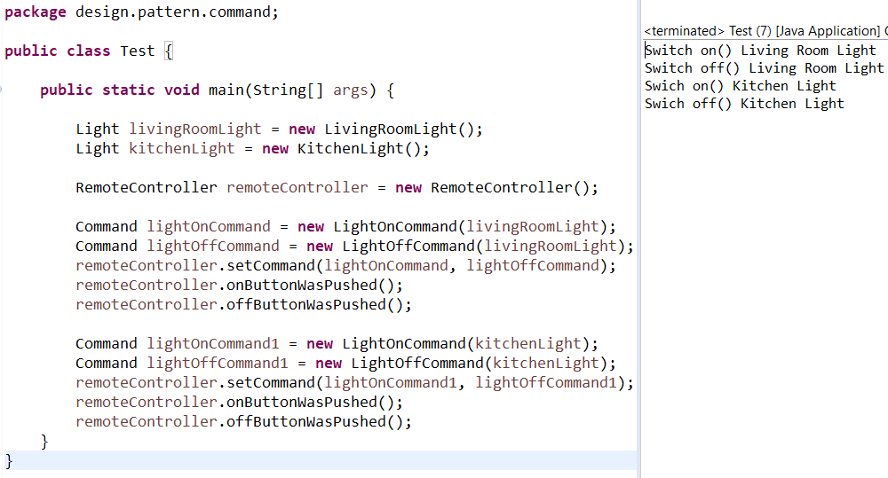
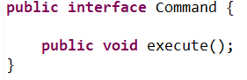
Exercise 01 - In class Activity
Assume that you have a light in both Living Room and Kitchen you use a Remote Controller to switch on and off lights. Command and Light interfaces are given with the Test class including final Output. Implement the OnCommand, OffCommand, LivingRoomLight, KitchenLight, and RemoteController classes.

Slide 12
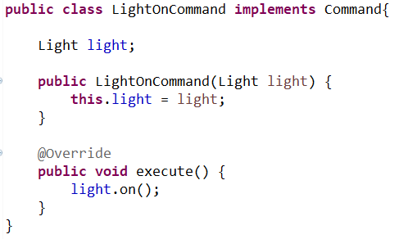
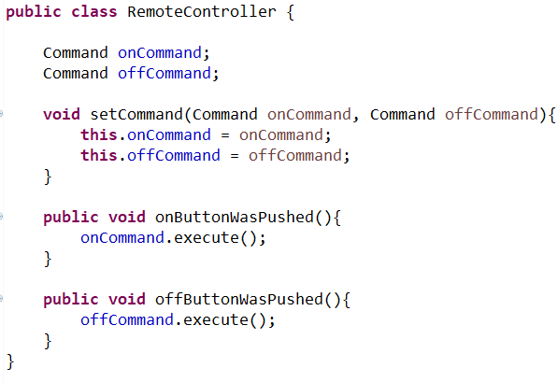
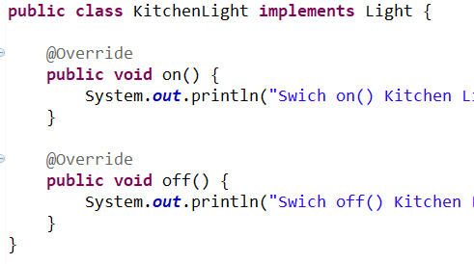
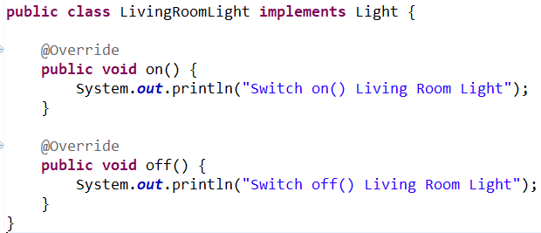
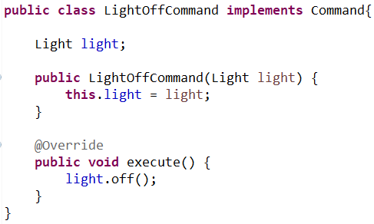

Slide 13
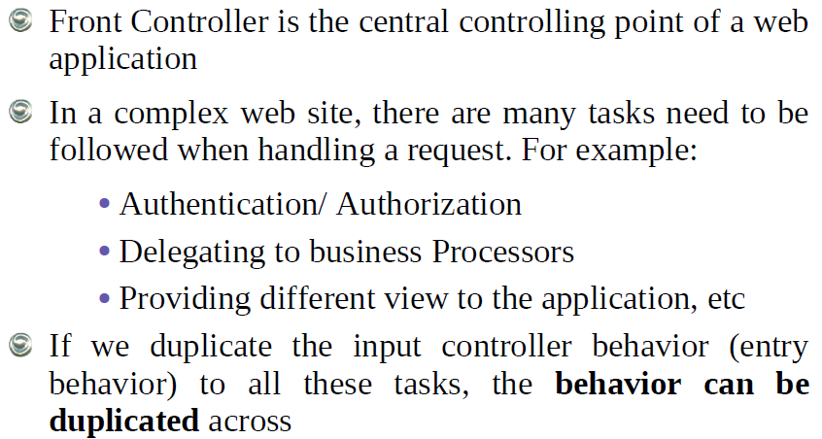
Front Controller

Slide 14
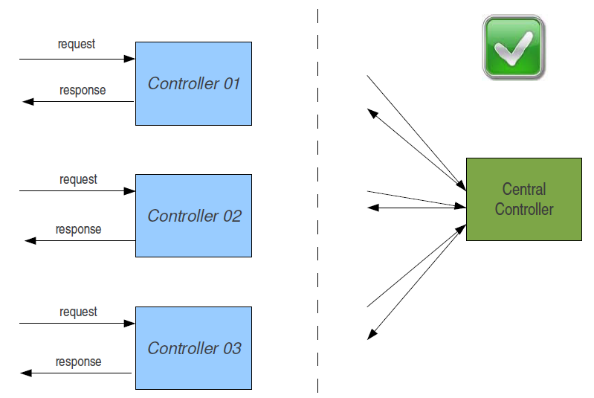
Front Controller

Slide 15
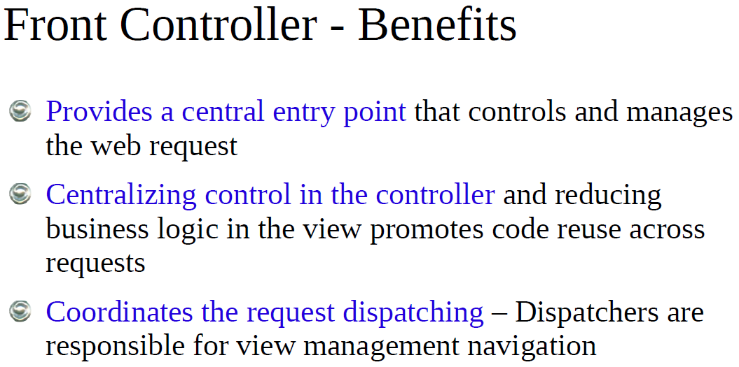
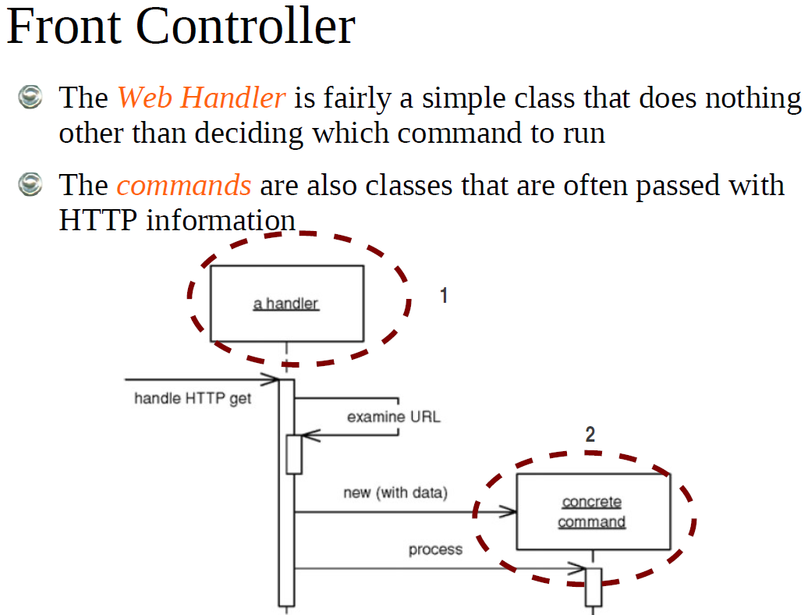

Slide 16
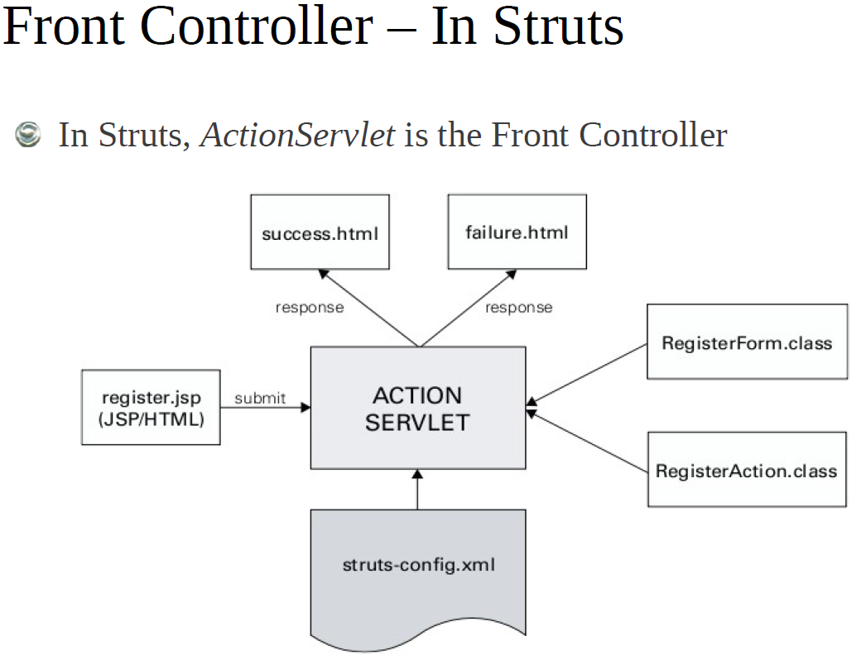
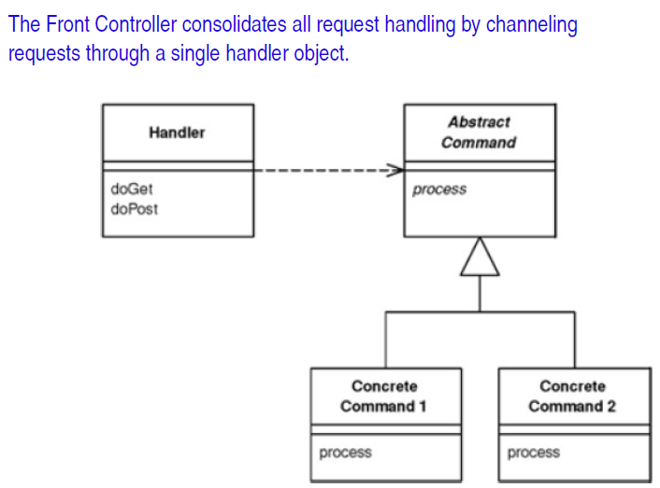

Slide 17
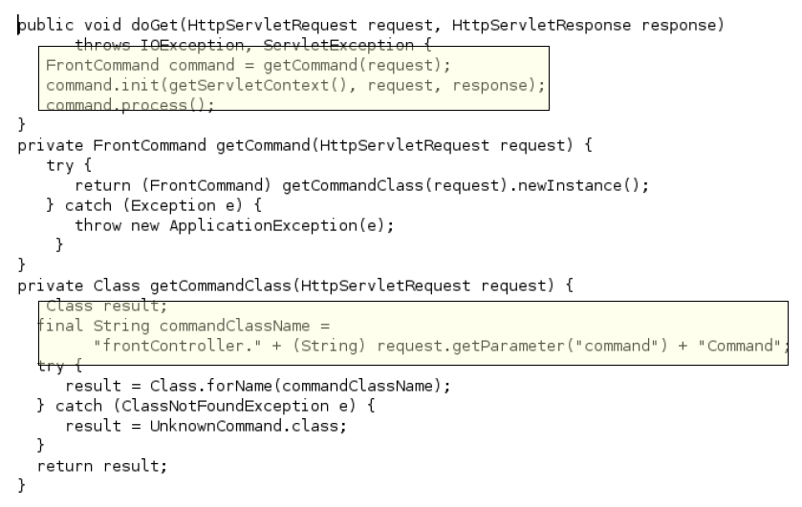
Front Controller

Slide 18
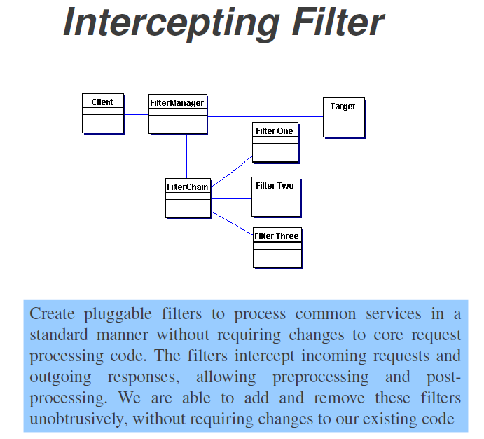
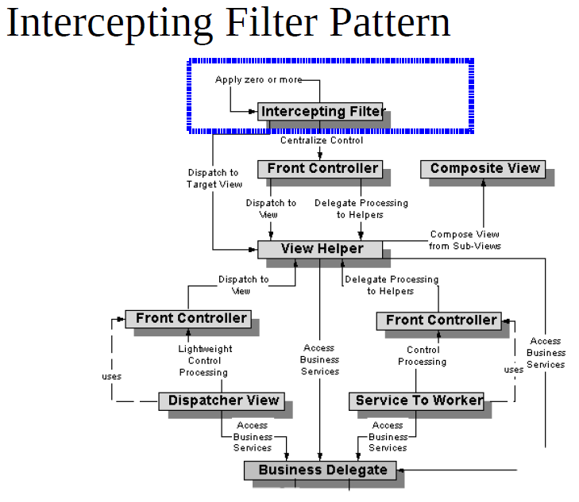

Slide 19
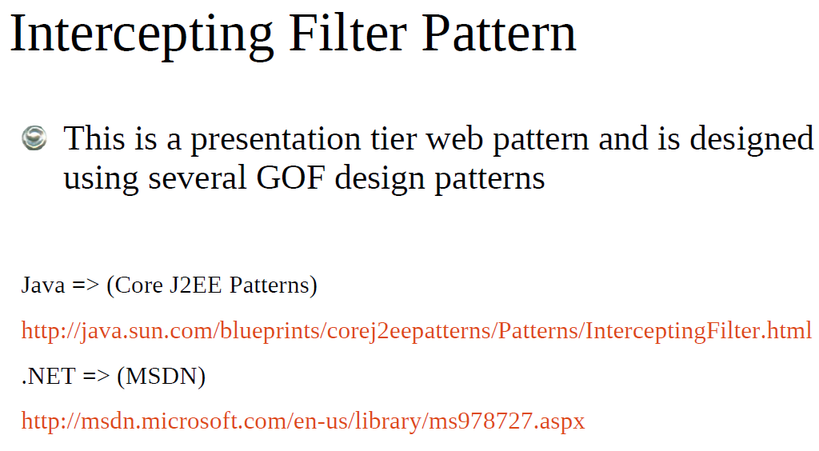

Slide 20
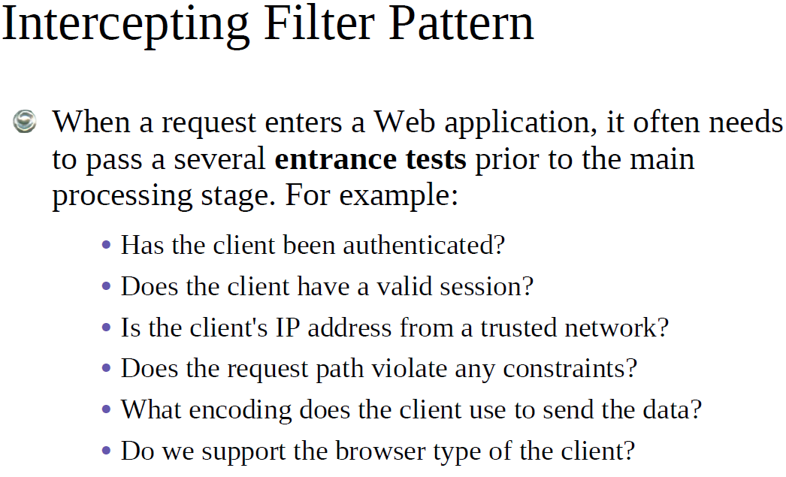

Slide 21
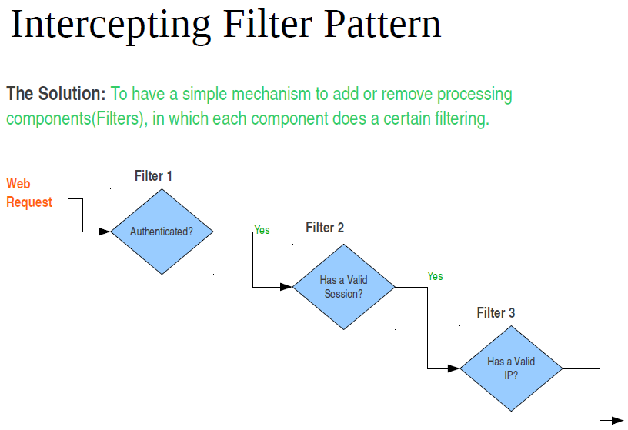

Slide 22
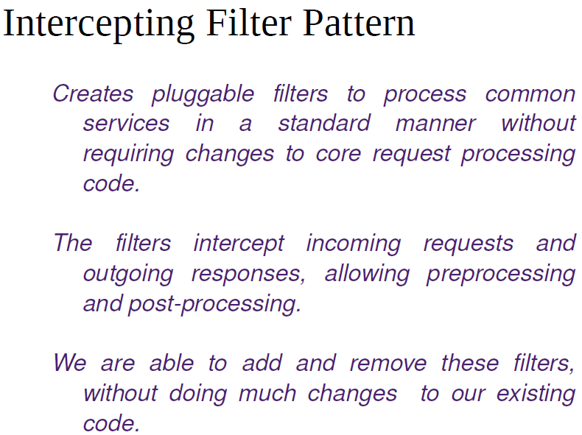

Slide 23
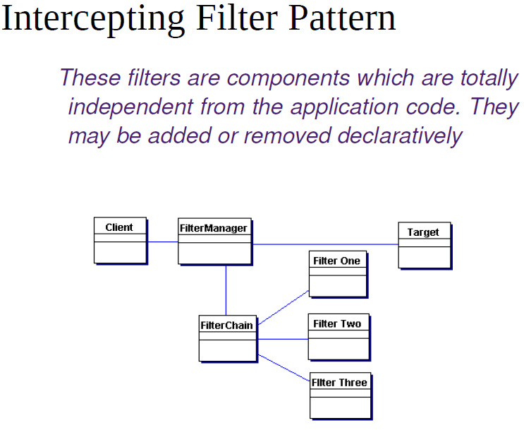

Slide 24
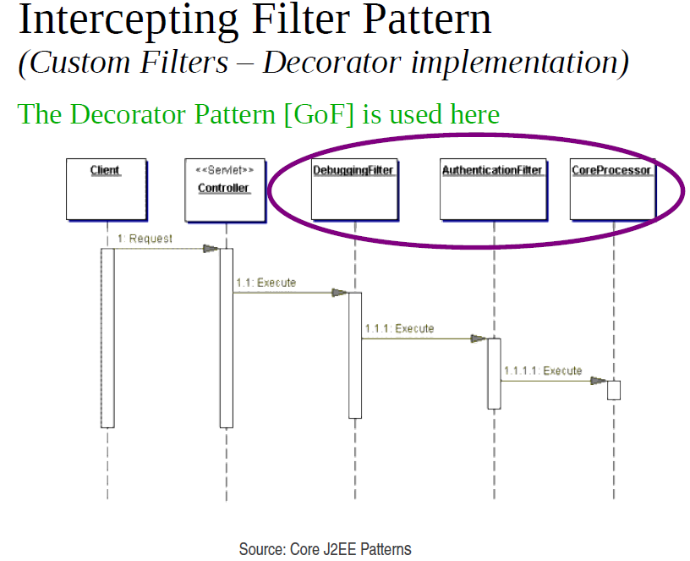

Slide 25
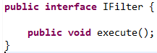
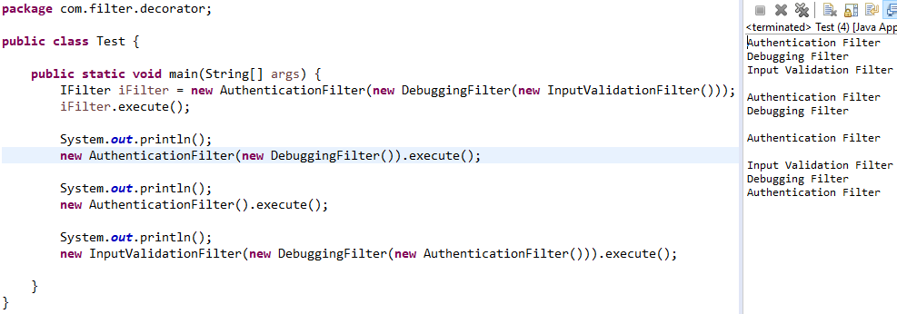
Exercise 02 - In class Activity
Write the code for three filter classes AuthenticationFilter, InputValidationFilter, and LoggingFilter. You should implement the interface IFilter and override the method. As per the displayed output modify your filter classes accordingly.

Slide 26
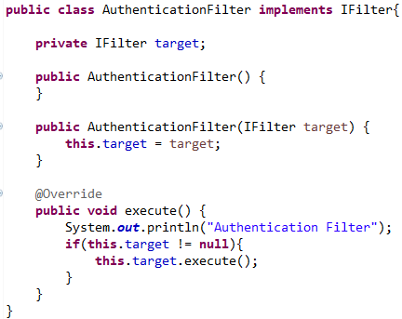
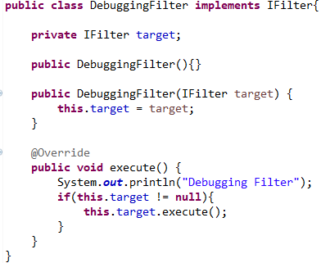
Solution

Slide 27
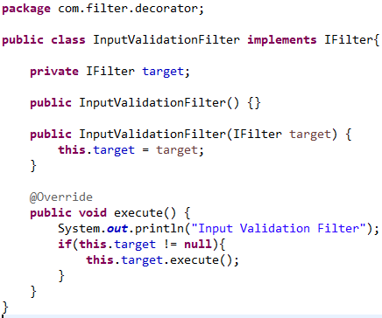
Solution

Slide 28
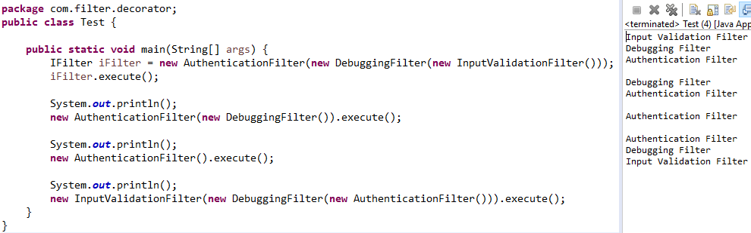
Exercise 03 - In class Activity
Remodify the above program it should start printing inner object to outer object as depicted in the console output.

Slide 29
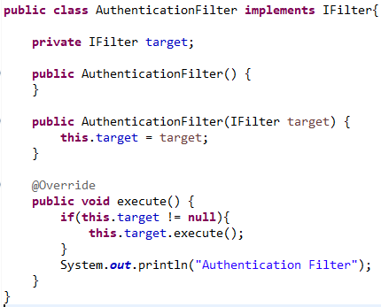
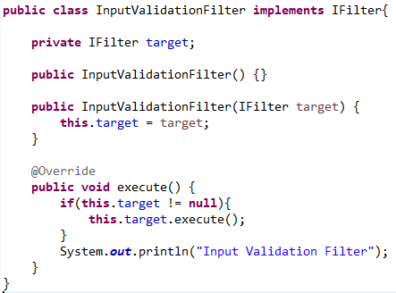
Solution

Slide 30
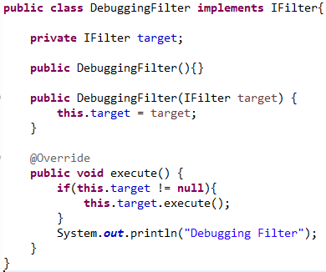
Solution

Slide 31
Intercepting Filter Non-Decorator Implementation

Slide 32
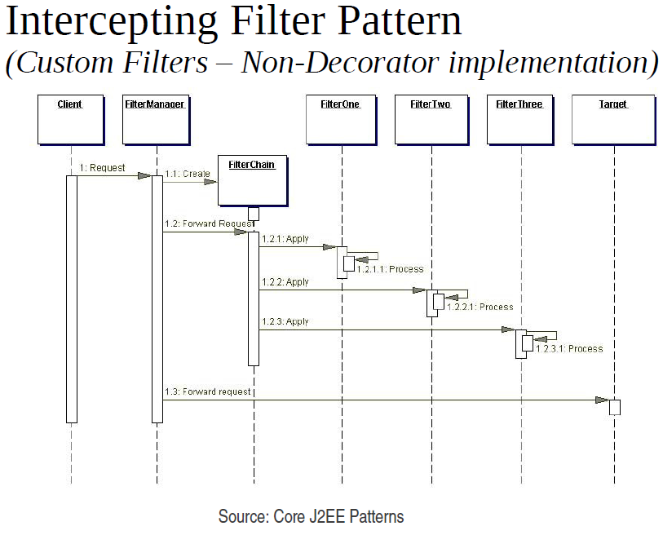

Slide 33
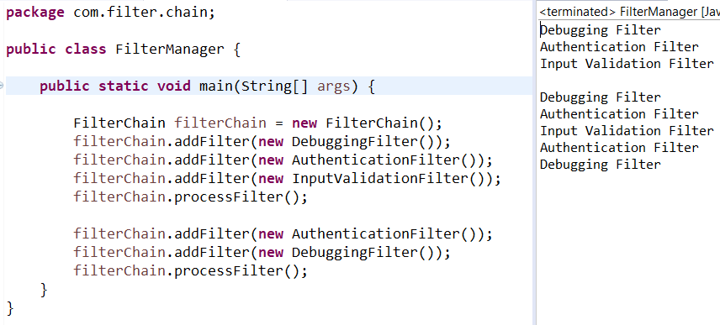
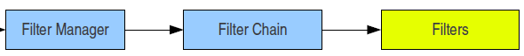
Exercise 04 - In class Activity
Remodify the above three filters according to the Non-Decorator Filter chain as per the below output. You should implement the same classes (AuthenticationFilter, InputValidationFilter, and LoggingFilter) and implement the interface IFilter and override the method. You can maintain chain of filters as ArrayList or Vector and use FilterManager class to invoke the Filter chain process. Filter Manager class is given below implement the FilterChain class. As per the displayed output modify your filter classes accordingly.

Slide 34
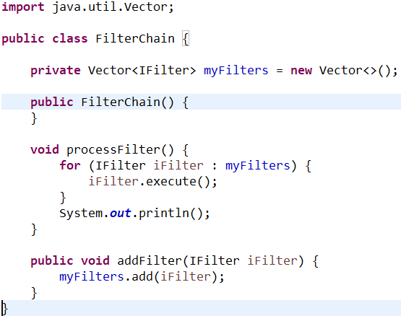
Solution

Slide 35
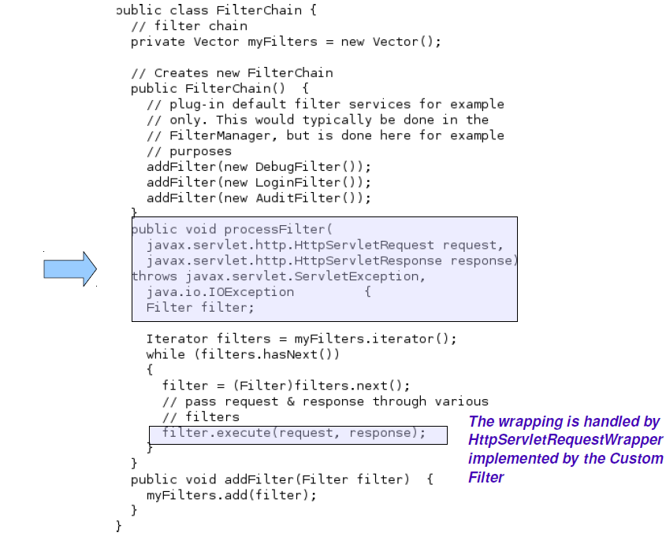

Slide 36
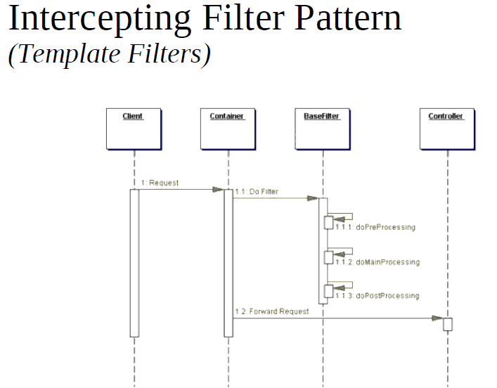

Slide 37
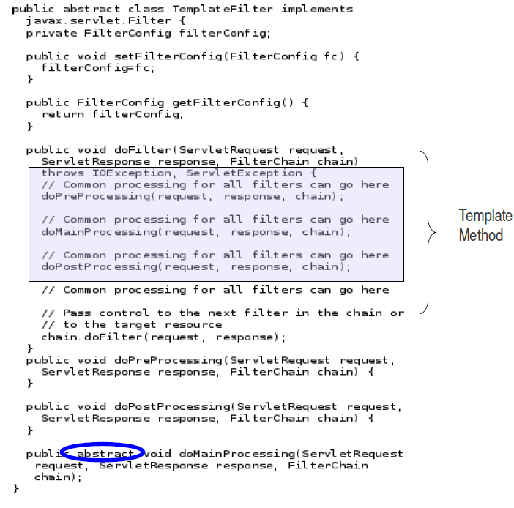

Slide 38
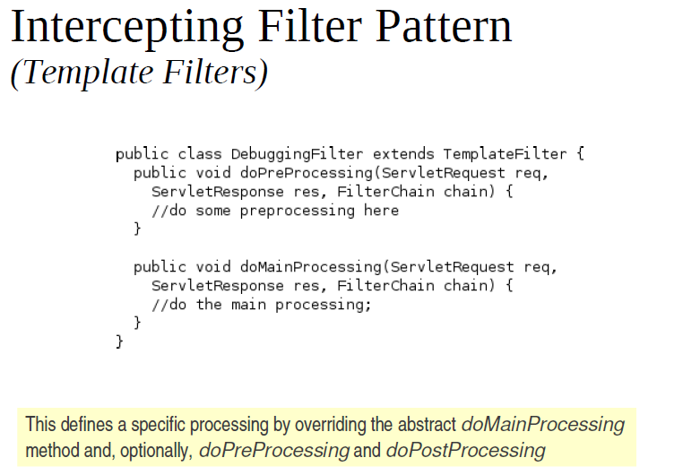

Slide 39
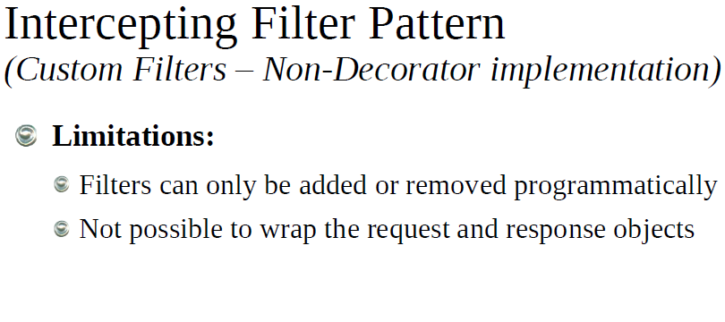

Slide 40


Slide 41



Slide 42

View Helper – why we need it?

Slide 43



Slide 44


Slide 45


Slide 46


Slide 47



Slide 48



Slide 49



Slide 50


Slide 51


Slide 52


Slide 53


Slide 54


Slide 55


